Slide 1

Team number: 33
Problem Statement: Mess Food Feedback Web App
Team members: 1} Siddharth Gautam
2} Shruti Raj
3} Saiyank Jaisi

Slide 2
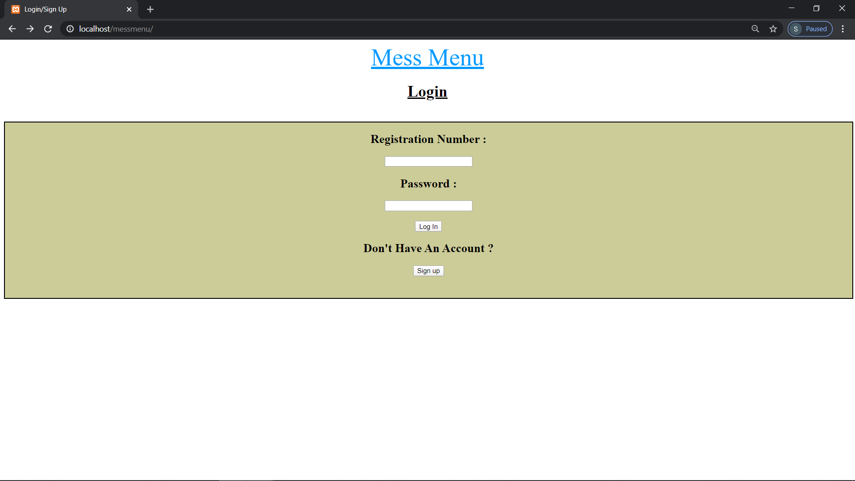
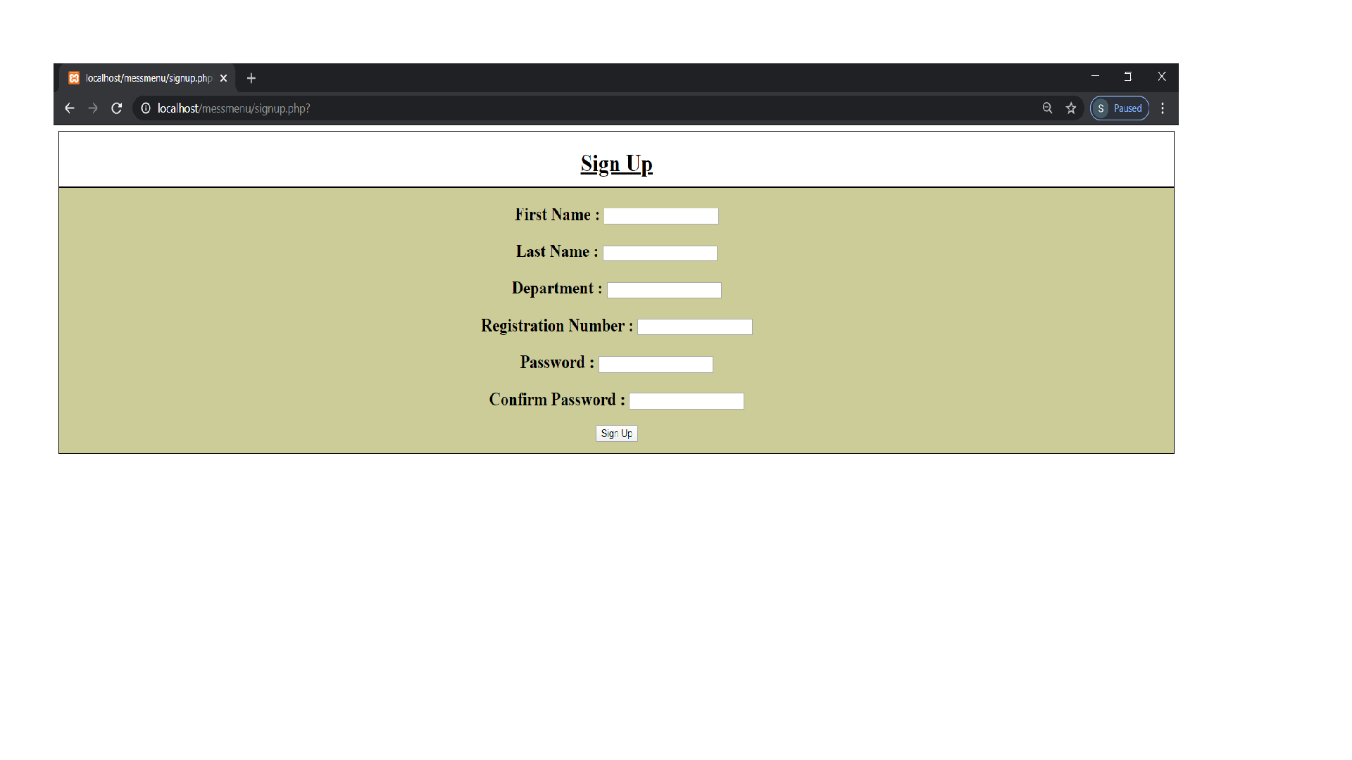
Sign in or Sign up

Slide 3
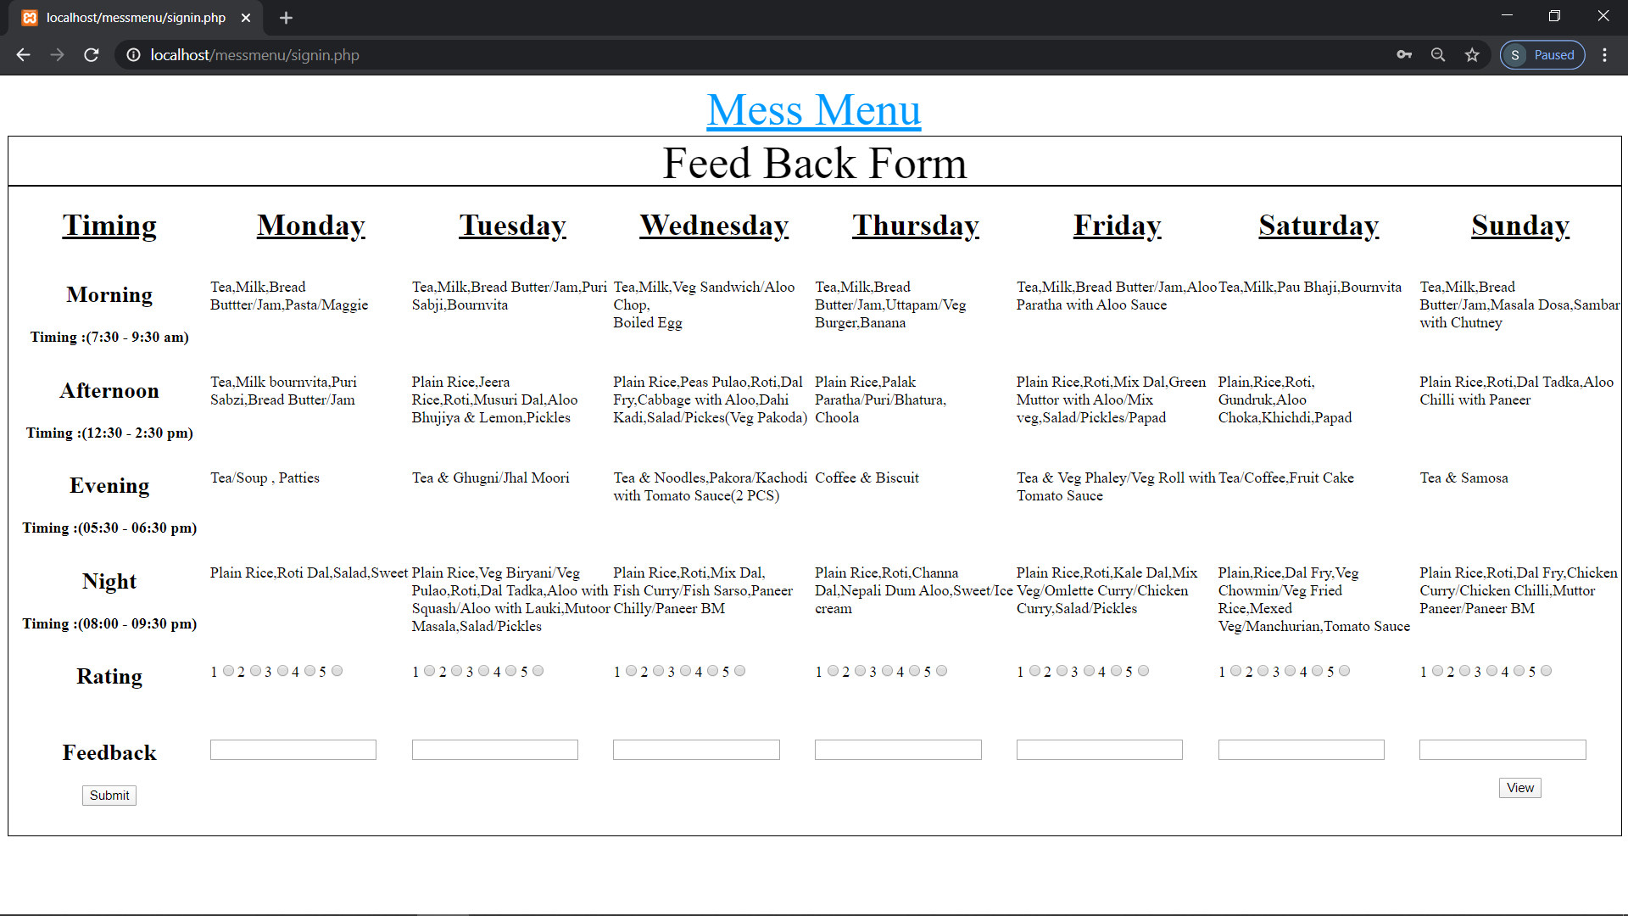
Feedback page

Slide 4
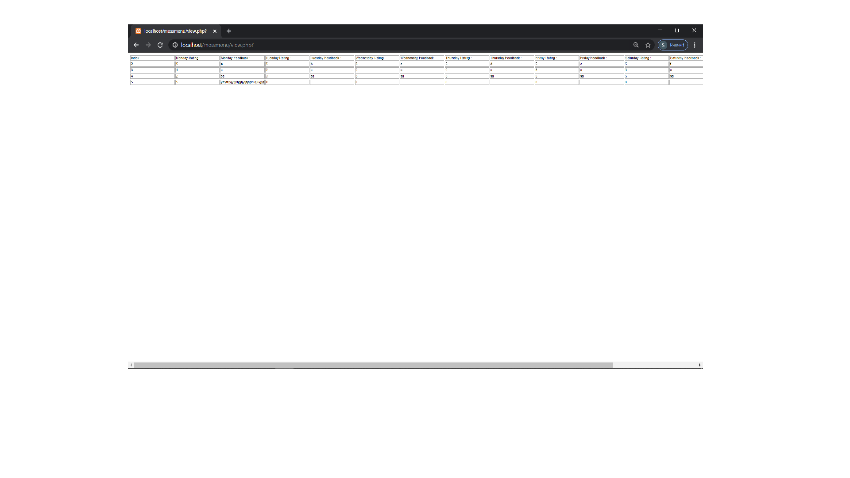
Feedback data storage

Slide 5


